Slide 1
Advanced R:
Functions, packages, & version control
Code profiling & parallel computing
Phil Novack-Gottshall
Benedictine University
pnovack-gottshall@ben.edu

Slide 2
Objectives
Today:
Practice using RStudio, GitHub, R Markdown
Understand logic of version control, Git and GitHub
Activity: Create GitHub account, practice workflow, and submit code to remote repository
Understand how R functions work
Activity: Analyze structure of an existing function
Activity: Write your own function (and submit to GitHub)
Understand structure of R packages
Activity: Build your own package
Tomorrow:
Improve coding efficiency using code profiling and timing tests
Activity: Profile your own function
Understand how to implement parallel computing
Activity: Run your own function “in parallel”

Slide 3
RStudio
A powerful integrated environment for using R

Slide 4
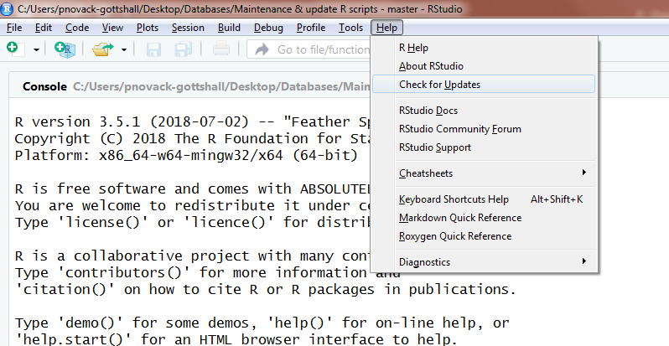
Who’s used rstudio before?
Download and install:
https://www.rstudio.com/products/rstudio/download/#download
If have, update!
Version 1.1.456
Update R, too!
Version 3.5.1

Slide 5
RStudio IDE
Integrated development environment (IDE) for R
Versatile open-source GUI interface
Fully integrated to R resources
Loaded with powerful and efficient add-ins for GitHub, building packages, and writing/formatting/trouble-shooting code
Widely used
Windows, Mac OS, Linux

Slide 6
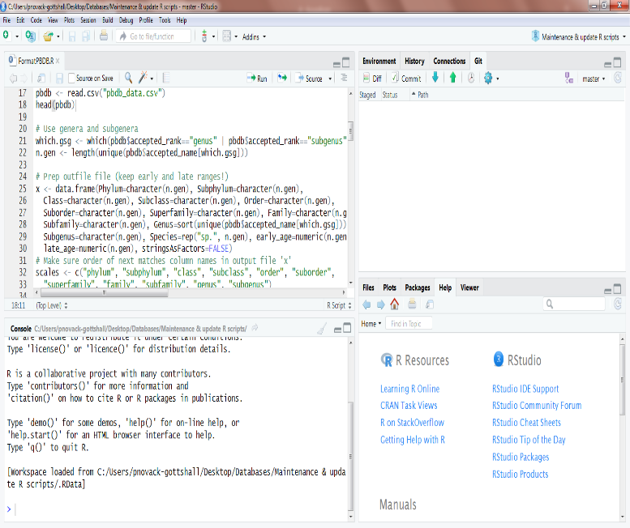
RStudio DEMO
Different panels
Common shortcuts (toggle between panels, execute)
"Modify keyboard shortcuts"
Environment summarizes data, objects, functions
Reflow comments and reformat code
Tag code sections with chapter-like "levels"
Autocompletion of functions and objects in code editor
Built-in help and plotting
Downside: no alarm()!

Slide 7
RStudio projects
Projects (.Rproj files) allow you to keep all documents, data files, code, and code history in their own folder
Each project file can be synced to GitHub
If building a package, advisable to set up within its own project
(Note: need to create the repository on GitHub before it will sync)

Slide 8
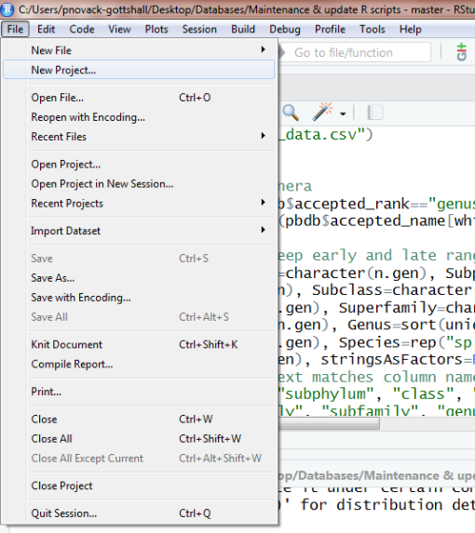
Creating a new project in rStudio
File > New project
New directory: Set up a "New project"
Choose "R package" if building a new package
Existing directory: If want to build a project around existing material
Version control: If want to create a project from a GitHub or Subversion repository
Let's walk through one of my projects

Slide 9
GitHub and version control
Collaborate, share, and understand how your code has changed

Slide 10
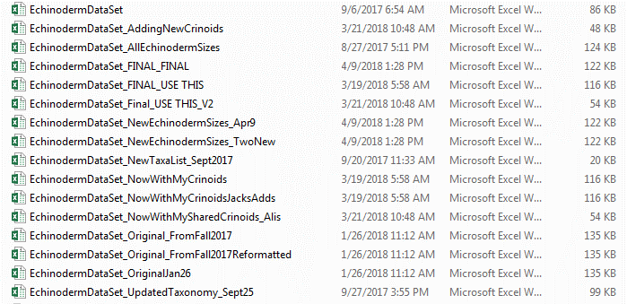
Look familiar?

Slide 11
Version control, Git & Github
Version control tracks changes to files
When changed? (timestamp)
Who made the change? (blame)
How changed? (differencing)
Seamless documentation of how code has changed through time
Prevents (tracks) errors
Allows collaborative code development
Coordinates changes among different users
Git is an efficient and commonly used version control system (VCS)
GitHub is an online repository for storing, exchanging, and sharing your files

Slide 12
Benefits of Git/GitHub
Version control: it makes it easier for you and users to track changes to your code over time
Changes (differences) are color coded for easy documenting
Integrated with RStudio while building your package / project
Above available even if do not submit to GitHub!
Users can request feature changes or post issues
Users can download beta packages directly to R
library(devtools)
devtools::install_github("pnovack-gottshall/ecospace")
library(ecospace)
Easily collaborate with others who are also developing your code
Allows you to test each code change across different computational environments if link your repository to Travis CI
When submit a CRAN package, can track downloads

Slide 13
Let’s look at the GitHub repo for my projects

Slide 14
Let’s install Git and create a Github account
Refer to handout

Slide 15
Repos & Branches
Software developers use VCS when developing software
PBDB also uses this development structure! https://github.com/paleobiodb
Repository ("repo"): The contributed files for a project/package/platform
Can be local or remote
Master: The central "production-ready" "public release" fully functioning GitHub repository
Never* work with the master directly!
(* unless you are the sole developer)
Branch: Where you work on one part of the project
There can be many branches
One branch for each new feature
Can be developed by one or several users
When done, branches are merged back into the master
Easier to create and merge branches via GitHub rather than RStudio (unless comfortable using shell commands)

Slide 16
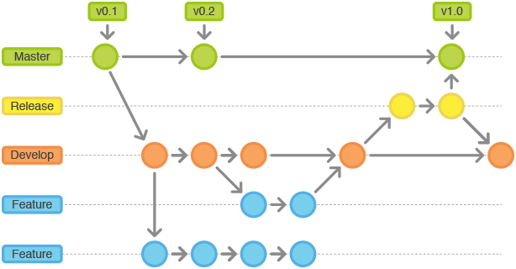
Master and Branches
https://stackoverflow.com/questions/20755434/what-is-the-master-branch-and-release-branch-for

Slide 17
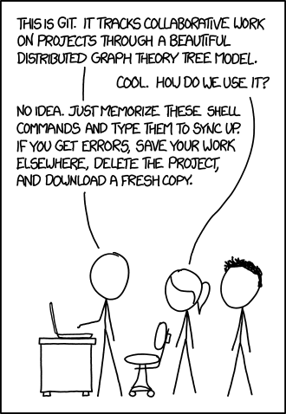
https://xkcd.com/1597/

Slide 18
Development work flow (Pull, stage, commit, & push)
Pull: When you download the current version from the branch/master
Also merges with your current code, if different
A fetch does not merge
1B. Resolve any conflicts indicated with a merge "<<<<<<< HEAD" tag
You are required to resolve it before you can "push" back to the branch/master
Make changes to your code
Changes are staged to be committed later
Commit: A formal (documented) commitment to your staged work
"Commit early and often“
All commits are version controlled with differences
Annotate (briefly) what each commit does
Push: When you upload your "commit" to the branch or merge to the master
Note differencing works with most text-based file types (but not Excel)

Slide 19
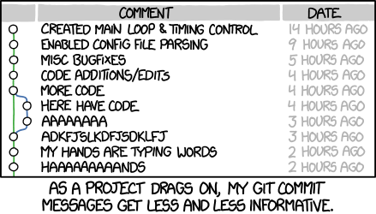
https://xkcd.com/1296/

Slide 20
Let’s work with the github repo

Slide 21
Functions in R
Do the things you need faster and simpler
“To understand computations in R, two slogans are helpful:
• Everything that exists is an object. • Everything that happens is a function call." — John Chambers (created S)

Slide 22
R functions
What are some of your favorite R functions?
What characteristics do you like in a nice function?

Slide 23
Basic syntax of R Functions
R is a function-oriented programming language
Basic syntax:
fn <- function(args, …) {
out <- …
return(out)
}
formals (arguments, args): the list of inputs
body (expression): what is being done
environment: each function is evaluated in its own “evaluation frame” environment
namespace: list of function/object names within a named environment (such as a package name)
Exception: primitive functions, like sum(), lack these elements and call C code

Slide 24
Naming functions (and objects)
Functions “do” things — give them “action” names
mean(), rnorm(), ecospace::create_ecospace(), paleoTS::fit3models(), MASS::fitdistr(), vegan::rarefy()
Objects “are” things — give them “noun” names
SpList, output1, ecospace, samples, traits, midpoints
CamelCase and Snake_Case for multiple word names:
Avoid all lowercase (and all UPPERCASE) if multiple words
SampleOne vs. sampleone vs. SAMPLEONE
Some coders recommend avoiding using periods to separate because periods mean things in some computer languages
SampleOne vs. Sample.One

Slide 25
Example of environments
f1 <- function (x) {
a <- x^2 + 1
return(a)
}
x <- 2
a <- 3
f1(x)
[1] 5
a
[1] 3

Slide 26
Example of environments
mean(1:3)
[1] 2
mean <- function(x) { "hello, world" }
mean(1:3)
[1] "hello, world"
base::mean(1:3)
[1] 2

Slide 27
Calling functions dynamically within other functions
y <- "pnorm"
y
[1] "pnorm"
class(y)
[1] "character"
y <- get(y, mode = "function", envir = parent.frame())
y
function (q, mean = 0, sd = 1, lower.tail = TRUE, log.p = FALSE)
.Call(C_pnorm, q, mean, sd, lower.tail, log.p)
<bytecode: 0x0000000016a4c458>
<environment: namespace:stats>

Slide 28
Calling functions dynamically within other functions
pnorm(c(-1, 0, 1), mean = 0, sd = 1)
[1] 0.1586553 0.5000000 0.8413447
y(c(-1, 0, 1), mean = 0, sd = 1)
[1] 0.1586553 0.5000000 0.8413447
Example:
install.packages("KScorrect")
l <- LcKS(rexp(50), "pnorm", nreps = 999)
l$p.value # < 0.05 means not normal distribution

Slide 29
Output from functions
Last assignment returned by default
Better to explicitly code what to return
return(out): returns (and prints)
invisible(out): returns without printing
Compare:
x <- function(x) {return(x)}
x(2)
x <- function(x) {invisible(x)}
x(2)

Slide 30
Output from functions
If more than one output value, typically output as a list
Example:
lm_out <- lm(Fertility ~ . , data = swiss)
str(lm_out)
If output is used in other package functions, output can be given a novel class
Example:
as.paleoTS() includes class(y) <- "paleoTS“
y <- as.paleoTS(mm=rnorm(10), vv=rep(1,10), nn=rep(25,10), tt=1:10)
class(y)

Slide 31
Warnings and errors
Help users by providing informative warnings and errors!
Do not go crazy with exotic troubleshooting
Every check adds time
GitHub issues can alert designers to common errors (or mis-uses) among users
Fine to insert brief comments in your functions
To add warnings that do not stop function:
if (…) warning("…")
To trigger an error that stops function:
if (…) stop("…")

Slide 32
Common scenarios to test for
What if input has missing data (NAs)?
Is it appropriate to call mean(), sum(), sd(), etc. with na.rm = TRUE
What if user provides different data class?
Trigger error if wrong class, inappropriate dimensions, incorrect names()
How does function handle NA, NULL, logicals, characters, and numbers?
Case-sensitive error in arguments?
Use tolower() or toupper() to internally fix case
What if nonsensical arguments?
Example, input negative values for a lognormal distribution or presence of ties for a continuous distribution
Trigger warning, and provide informative explanation of why inappropriate!

Slide 33
R Style Guide
The R style guide helps keep coding clear and understandable for others (and you)
https://google.github.io/styleguide/Rguide.xml
In RStudio, highlight text and Code>Reformat Code (Ctrl/Cmd+Shift+A)
Reindent comments with Code>Reindent Lines (or Ctrl/Cmd-I)
My gripe: series of commas in functions and long series of values!
Other packages:
‘formatR’ is similar to RStudio, somewhat more flexible, somewhat idiosyncratic in certain circumstances, and works MUCH better for series of arguments in functions
‘styler’ is similar, too, and allows custom style rules
‘lintr’ checks code within RStudio and issues warnings if non-standard

Slide 34
Activity: Learn from others
With a partner, pick a favorite function and study how it works
Identify:
args(function) / formals(function)
Is “...” an allowed argument? If so, how handled?
environment(function)
body(function)
str(output)
What inherent trouble-shooting is included (if any)
Are object classes checked?
What conditions trigger warnings vs. errors?
What is returned?
What is the structure of the output?
How does the function work?

Slide 35
Submit a function to the APW github repo

Slide 36
Packages in R
Help yourself and help others replicate your analyses

Slide 37
Packages
install.packages("x")
CRAN: Comprehensive R Archive Network
Network that hosts R and R packages
install.packages("package")
library("package")
Easily built in RStudio:
New Project > New Directory > R Package
Give name, choose folder location, and check “Create a git repository”
Automatically creates all necessary file templates and folders

Slide 38
Package structure
In RStudio: File > New project > New directory > R package:
R/ folder: separate .R file for each function
man/ folder: function documentation for each function
DESCRIPTION file: Describes package
NAMESPACE file: Describes the environment
Following are optional:
data folder: where package-supplied example data objects are stored
tests folder: if include test checking in your workflow
.gitignore: List what git should ignore
.Rbuildignore: List what RStudio should ignore when building the package
.travis.yml: How should Travis CI test your package on different platforms?
NEWS.md: Document revision changes
README.md: GitHub ReadMe “homepage”
revdep folder: Folder for testing reverse dependencies
vignettes folder: Where R Markdown package vignette (tutorial) is stored

Slide 39
Let’s examine some examples

Slide 40
R/ and man/ folders
Separate .R files (in R/ folder) and .Rmd files (in man/ folder) for each function
Only edit .R files!
RStudio builds .Rmd documentation file internally when package is built
(Exception: write .Rmd file if creating a vignette)
RStudio creates placeholder .R file when create new package project
Uses Roxygen2 R Markdown formatting to tag:
Title (first line)
Description: Brief summary of what function does
Usage: function body, with default args
Arguments definitions, one for each arg
Details: Additional notes on how functions works
Value: What the function returns
Note: Anything else relevant
Authors
References
See also: Other functions of relevance
Examples

Slide 41
DESCRIPTION file
Summary of package
Title, version, date, description
Open source license
Depends (dependencies)
Packages your function requires (including R version)
(Reverse dependency: List of packages that depend on your functions)
Imports: Packages that some but not all functions require
“Import” packages are downloaded with package but only loaded into namespace when called by require()
Suggests: Packages used in accompanying vignette but not .R functions / examples
Written using R Markdown-like tags

Slide 42
A side on versioning…
Standard format has 3 numbers (e.g., R 3.5.1 or vegan 2.5-2)
1st number: Substantially new version
2nd number: Major feature additions/changes
3rd number: Minor changes, typos, fixes
0.0.1 is standard first (unreleased) development version
1.0.1 is standard first released version
Most R packages will likely not go above 1.x.x
Example: Check out vegan DOCUMENTATION for v. 2.0-0
news(package="vegan")

Slide 43
NAMESPACE file
Functions (by name) that the package exports and imports
Names get added to the searched environment when package is loaded by library() or require()
RStudio builds internally when package is built
Based on “@export” tag in each .R file
Also includes functions “imported” from other packages

Slide 44
Data & tests folders
Data folder
Where package-supplied example data objects are stored
Rdata (.rda) file format saved and formatted automatically in RStudio using:
devtools::use_data(data)
Tests folder
Best practice recommends including test-checks in your workflow
See earlier function tests list for common cases

Slide 45
News and vignettes
NEWS.md
Add each version and date
Briefly list feature changes and other fixes
Acknowledge those who provided assistance or noted issues
Vignette
Tutorial to provide broader context and more comprehensive examples illustrating how to use package (with other packages/functions)
Typically written in R Markdown (.Rmd file)
RStudio prints as a html (or pdf) that can be called within R
vignette("PackageName")
To build in RSTudio, type:
devtools::use_vignette("my-vignette")

Slide 46
Now pair up and check out some R packages on github
Github is a great place to see how others have built their packages!
Search GitHub (“All GitHub”) for “______ package” and language=R
(“ecology”, “phylogenetics”, “morphometrics”, etc.)

Slide 47
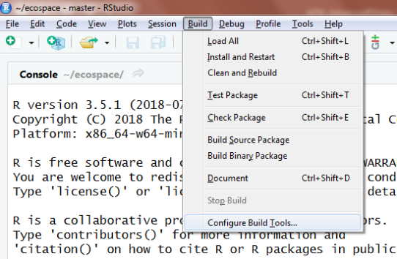
Build a package in RStudio:
install.packages(c("devtools", "markdown", "roxygen2", "testthat", "knitr"))
Contains basic functions to build, compile, and troubleshoot packages
New Project > New Directory > R Package
Give name, choose folder location, and check “Create a git repository”
Automatically creates all necessary file templates and folders
Build > configure Build tools > Build tools > check “Generate documentation with Roxygen” and in Configure check all options (Rd files, Collate, field, NAMESPACE file (& Vignettes if using), and the R CMD check, Source/Binary & Build & reload
Automates building of .Rmd files in man/ folder

Slide 48
Convert your R function into a .R file
Create a new Package project (e.g., Phil’s R toolkit)
Do not connect to our APW repo (but can connect to your own if desired)
Use template in R/ folder to build your .R file
Or build using File > New file > R documentation
Make sure to define (A) title, (B) description, (C) args, (D) value, & (E) examples
If time, fill out DESCRIPTION file
See Template.R for a better .R template

Slide 49
Workflow to build your package
In RStudio, Ctrl/Cmd+Shift+L to load all
In RStudio, Ctrl/Cmd+Shift+B (Build > Install & restart) to build package
Builds .Rmd files, NAMESPACE, etc.
In RStudio, Ctrl/Cmd+Shift+E (Build > Check package) to troubleshoot / check the package

Slide 50
Use RStudio to write & build your .R function (and .Rmd) files
View helpfile for your function and check examples

Slide 51
Add your .R file to our APW repo
I’ll build a combined package and post to github
You can download by pulling, or calling:
library(devtools)
devtools::install_github("pnovack-gottshall/APW")
library(APW)

Slide 52
R Markdown
Document your code

Slide 53
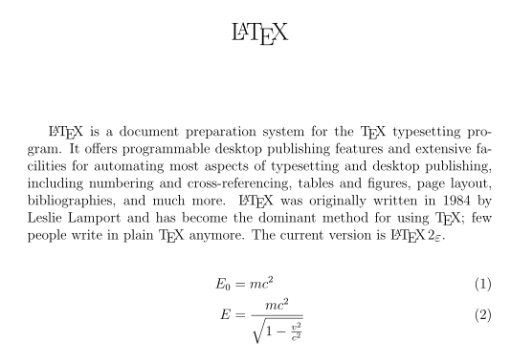
Latex, Sweave, and R Markdown
Philosophy: Focus on text instead of formatting!
LaTeX is a text “language” that uses simple tags to convert to publication-quality products
Widely used in math and physical sciences (among others)
Sweave: Implementation of LaTeX for R that incorporates blocks for R code and graphs
Not easy to code!
R Markdown: Simplified analog to Sweave
(mostly) easy to code!
Required format for officialR journals
‘Markdown’ package: Simplified text (and table/equation/code) formatting
‘knitr’ package: Incorporate code and code output (graphs, etc.)
Allows dynamic output (use Shiny for dynamic user-interface apps)
Code can specify different text depending on statistical results!

Slide 54
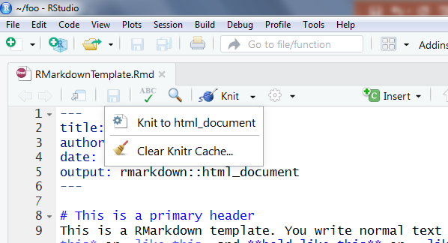
Sample R Markdown template
To open a new template in RStudio, using File > New File > R Markdown
Creates template with editable YAML header
install.packages(c("htmltools", "caTools", "base64enc", "rmarkdown"))
Refer to handout for standard tags (and nice intro!)
Open RMarkdownTemplate.Rmd in RStudio and render it using knitr
Change from html to pdf
Change some formatting

Slide 55
Standard R Markdown tags
Headings: # , # # , # # # , etc.
Italics: *italics* or _italics_
Bold: **bold** or _ _italics_ _
Code:
```{R}
x <- rnorm(100)
plot(x)
```

Slide 56
How to build a vignette in RStudio
Create template and directory with:
devtools::use_vignette("my-vignette")
Html format is standard format for R vignettes
pdfs and Word docs also possible
Edit and write using Rmarkdown tags
Render with Ctrl/Cmd + Shift + K (or knitr button)

Slide 57
code Profiling
Increase your code speed

Slide 58
Code profiling and timing packages
Packages and functions:
Rutils::Rprof
Use to identify time bottlenecks within functions
‘microbenchmark’
Use to evaluate timing of individual functions (expressions)
See Kowalewski’s tutorial for great example using t.test()!
system.time(replicate(1000, expr))
Old-fashioned version of microbenchmark
Sys.time()
Useful for timing longer code algorithms

Slide 59
Rprof: Profiling your code to identify time bottlenecks
Rprof(tmp <- tempfile()) # Start profiling (store to tmp file)
example(glm)
Rprof() # End profiling
summaryRprof(tmp)
# Output tallies:
# by.self: time spent in function alone.
# by.total: time spent in function and callees.
# sample.interval: the sampling interval (by default every 20 msecs).
# sampling.time: total time of profiling run. Remember that profiling does impose a small performance penalty.

Slide 60
library(KScorrect)
gc() # Good to dump memory first so doesn't occur during test
Rprof(tmp <- tempfile())
x <- runif(100)
Lc <- LcKS(x, "plnorm")
Rprof() # Turn off the profiling
summaryRprof(tmp) # Evaluate results
Conclusion: The LcKS(), as.vector(), ks.test(), and y (="plnorm" function) calls take the most time
Makes sense because these functions are called 4999 times!
But no major bottlenecks
Some of these functions were avoided or modified with v. 1.3.1
Check GitHub repo for history of changes

Slide 61
Profile your functions!
What is your bottleneck? Can you speed it up?

Slide 62
tips for improving code performance
Use code profiling to find bottlenecks
Functions typically run slower on data frames
Convert to matrix or use individual columns when possible
Run “in parallel” if using time-intensive apply() or for()-loops
Re-write time-intensive portions of code in C++
Recommended from https://csgillespie.github.io/efficientR/performance.html

Slide 63
Parallel Computing
Harness your computer’s innate supercomputer

Slide 64
Modern computers & Multitasking
All commercial computers use parallel processing to multitask!
How many CPUs (cores) does your computer have?
library(parallel) # Comes with R!
detectCores(logical = F) # Num. of physical cores
detectCores(logical = T) # Num. of functional cores
Hyperthreaded CPUs allow two functional CPUs per CPU chip
You can visualize CPU (and networking) activity on your computer:
Windows: Task Manager
Mac: Activity Monitor

Slide 65
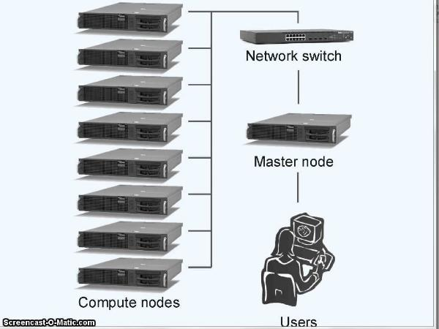
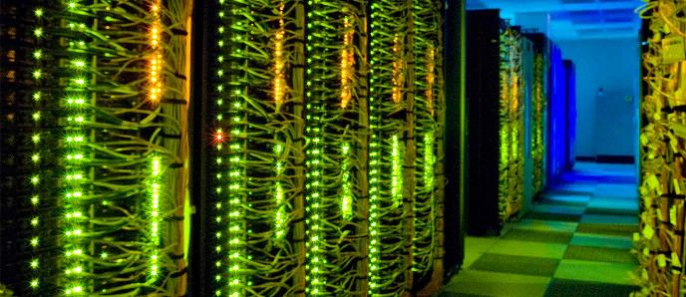
Parallel Infrastructure
Master node and worker nodes form a cluster
If network designed for cluster computing and has many (>>100) worker nodes (cores), it’s high-performance computing (HPC)
https://hpcc.usc.edu/about/
USC’s HPC has 560 nodes and is 12th fastest in US (as of June 2018)

Slide 66
When to run in parallel
“Embarrassingly parallel”
When you are running the same algorithm many times
Bootstrap and resampling algorithms, for() loops, apply() functions, sample processing, optimization routines, Monte Carlo simulations involving many replicate analyses
Not appropriate for: running one Monte Carlo simulation, optimization, or MCMC posterior estimation
Communication effort between nodes can substantially increase “processing” time
More CPUs does not always mean faster
Trade-off between:
Amount of information communicated
Time for one iteration
Number of worker nodes
Processing time
# CPUs (=communication effort)

Slide 67
Parallel implementations
Standard:
Divide x iterations among n worker nodes and send x / n chunks to each worker upfront
Load-balancing (LB):
Use when processing time varies (substantially) among iterations or when worker nodes have (substantially) different processing speeds
Can be slower because of higher communication effort
Some nodes may never get “called”

Slide 68
Caveats for HPC
Most research universities have HPC facilities
Running R requires working with their computer scientists
Different technical implementations for different mainframe infrastructures
Different communication requirements
r-sig-hpc@r-project.org listserv is a good resource!
Most facilities require run-time reservations and use time limits

Slide 69
RNG in parallel computing
Random number generation (RNG) is a critical concern with parallel computing
Try this (only works for Macs where parallel “forking” occurs):
Run RNG_in_parallel.R
Solution:
A RNG seed is created in master, then a RNG sequence stream is distributed separately to the workers (L'Ecuyer, 1999; L'Ecuyer et al., 2002)
Allows replicability but independence among worker processes
Incorporated in ‘parallel’ via set.seed(kind = "L'Ecuyer-CMRG")or using library(rlecuyer)
Note repeatability is not (typically) possible if using load-balancing

Slide 70
Running your code in parallel
Functions vary depending on Windows, MacOS, LINUX, etc.
See Parallel.R for sample code using ‘parallel’ and ‘doParallel’
Most packages recommend using n – 1 cores
Reserves one for the “master”
Other packages:
‘parallel’ (in base R, and based on ‘snow’ and ‘multicore’)
‘snow’ (for Windows)
‘multicore’ (for Mac OS and Linux)
‘Snowfall’ (more intuitive functions for ‘snow’ with improved troubleshooting and error logging)
‘doParallel’ (used with ‘foreach’ package)

Slide 71
Strengths and weakness of ‘parallel’
‘parallel’ (and ‘snow’, ‘multicore’, and ‘snowfall):
Allow fine user control over implementation details
Straightforward to implement across high-performance computer cluster
Bundled with base R
OS-specific functions require greater knowledge of parallel processing options
Work as variants of lapply() and require parallel algorithms to be written as more complicated stand-alone functions
Output is a list that needs to be unlist()-ed
Not always trivial if a very large output

Slide 72
Strengths and weakness of ‘doParallel’
Wrapper to parallel that internally calls ‘snow’ or ‘multicore’ functions based on user’s OS and computer CPU allowances
Standard functions work across all operating systems
Simpler blackbox: requires the least knowledge of how parallel computing works
Useful feature if using parallelization within cross-platform packages
If calling via foreach::foreach() %dopar% {…} :
Can use “raw” code (rather than a function)
Syntax more like a for() loop than a function
Can output in multiple formats (vector, list, mean or sum of an array, etc.)
Can control implementation details, but requires bit more effort
If needed, why not just use ‘parallel’, etc. directly?
Blackbox: Letting package determine parallel implementation can produce suboptimal (i.e., slower) results

Slide 73
Converting your functions to parallel-ready versions
Most parallel packages (‘parallel’, etc.) require users to rewrite their code as a stand-alone function and use lapply()-like implementation
Each element is run as an independent sample/iteration
To code:
Include any necessary “inputs” as args within the function
Include “switching” args for different ways (e.g., parameters to change) you run your code
Basic syntax (using lapply() as example)
sq <- 1:num.iterations
out <- lapply(x = sq, FUN = function, …)
unlist(out)

Slide 74
Running using ‘doParallel’ and ‘foreach’
To code:
cl <- makeCluster(3) # Set up 3 worker nodes
registerDoParallel(cl) # Set up parallel backend
output <- foreach(i = 1:num.iterations, .combine = c) %dopar% {
. . .
}
stopCluster(cl)
Can return concatenated vector, list, rbind, cbind, sum, or mean of each independent parallel run.

Slide 75
Rewrite your functions & Run in parallel
Who’s code speeds up? By how much?
Who’s slower? WHY?
Refer to Parallel.R for sample code

Slide 76
References
GitHub tutorial: https://www.atlassian.com/git/tutorials/learn-git-with-bitbucket-cloud
GitHub and RStudio: https://support.rstudio.com/hc/en-us/articles/200532077?version=1.1.456&mode=desktop
Hadley Wickham's R Packages ebook: http://r-pkgs.had.co.nz/
Hadley Wickham's Advanced R ebook: https://adv-r.hadley.nz/
R code style guide: https://google.github.io/styleguide/Rguide.xml
R Markdown with RStudio: https://R Markdown.rstudio.com/
R Markdown comprehensive ebook: https://bookdown.org/yihui/bookdown/
Code profiling: https://adv-r.hadley.nz/profiling.html
Parallel computing: https://www.r-bloggers.com/how-to-go-parallel-in-r-basics-tips/
Parallel computing: https://www4.stat.ncsu.edu/~post/isaac/parallel_programming_R.pdf

